Slide 1

MINI PROECT-1
- SPANDANA BAINDLA

Slide 2

AGENDA
LAB -1 IAM HANDS ON
LAB -2 BILLING ALARAM
LAB -3 S3 BUCKET
LAB -4 EC2 INSTANCE
LAB -5 SECURITY GROUPS
LAB -6 VOLUMES AND SNAPSHOTS
LAB -7 AMI’S
LAB -8 LOAD BALANCERS
LAB -9 ASG AND LT
LAB -10 RDS

Slide 3

WHAT IS AWS ?
Amazon Web Services (AWS) is a cloud platform.
IMPORTANCE OF AWS
AWS is flexible,
secure
cost-effective

Slide 4
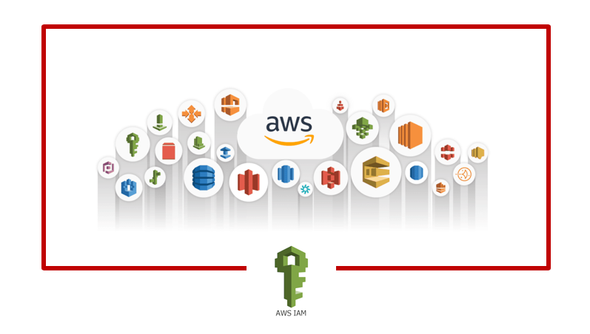
IAM HANDS ON
IAM (Identity and access management) allows us to manage access to AWS services and resources securely. This hands-on tool ensures secure access management.
Key Features:
Authentication
Policies and permissions
Access Keys for Programmatic Access

Slide 5
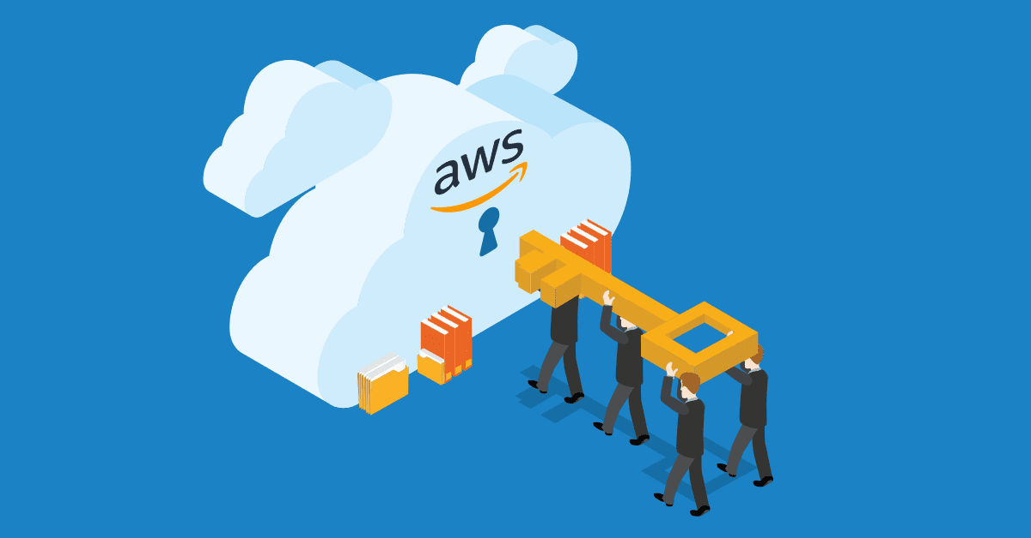
MULTI-FACTOR AUTHENTICATION
Multi-Factor Authentication (MFA) is an security for accessing systems or applications. MFA reduces the risk of unauthorized access. By requiring multiple forms like given bekow.
There are three ways to setup an MFA :
Passkey or Security key
Authentication app
Hardware TOTP token

Slide 6

SETUP AN MFA TO ROOT USER
Sign in to AWS Management Console
In the top-right corner, click on your account name select Security Credentials.
Scroll down to the MFA section.
Click on Activate MFA.
We can able to see three options select one option
6. Assign MFA

Slide 7
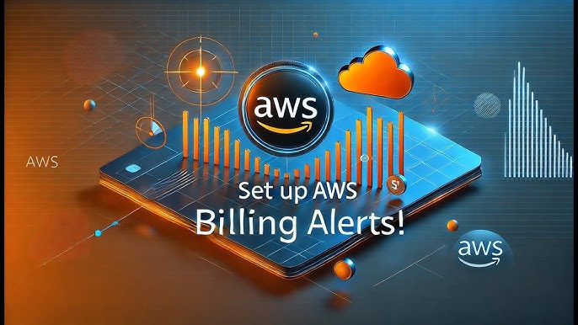
BILLING ALARAM
Billing Alarms help us control costs by notifying us if spending goes above a set limit making it easy to control from unexpected charges and ensuring we stay within our budget.
SETUP FOR BILLING ALARAM
Access the Billing Dashboard
Navigate to Budgets and Create a New Budget
Set Budget Details
Set up alerts when usage or cost exceeds and set the threshold (e.g., 80% of the budget amount).
Set Notifications enter the email addresses where you want the notifications sent.
Review and click on create budget.

Slide 8

S3 BUCKET
Amazon Simple Storage Service (S3) allows us to store data in buckets and retrieve data easily you can access your files from anywhere, at any time, as long as you have an internet connection.
Create Bucket: Upload a test file and access it via URL (initial error).
Check Permissions: Make the file public and access it via the browser.
Enable Versioning: Upload a new file version and verify both versions.
Delete File: Use versioning to access the deleted file.

Slide 9
ELASTIC COMPUTE CLOUD (EC2)
Amazon EC2 (Elastic Compute Cloud) is a service that lets you rent instances in the cloud. You can choose the size and power of the computer based on what you need. It's flexible, so you can easily increase or decrease the resources as your needs change, and you only pay for what you use.
Create an EC2 Instance: Launch a t2.micro instance with Ubuntu as the operating system (eligible for the Free Tier).
Set Up Security Group: Configure the security group to allow access to necessary ports, like SSH (port 22), so you can connect remotely.
Use SSH to connect to the instance using PuTTY or a similar SSH client. Connect to the Instance:

Slide 10

SECURITY GROUP
Security Groups act as virtual firewalls for your EC2 instances. They define rules that control the incoming and outgoing network traffic.
Create a Security Group: Name the security group as desired and check the default rules provided.
Set Inbound Rules: Allow access on ports 80 (HTTP) and 22 (SSH) from your specific IP range
Associate with EC2: Attach the newly created security group to your existing EC2 instance.
Verify Access: Test the SSH connection to ensure you can successfully connect to the EC2 instance.

Slide 11
VOLUME AND SNAPSHOTS
Volume: Volumes are like virtual hard drives that are attached to your EC2 instances. They store data and files, just like a physical disk, and can be created, resized, and attached to instances whenever needed.
Snapshot: Snapshots are backups of your volumes. They capture the state of a volume at a particular moment in time, allowing you to restore or create new volumes from that backup later. It’s like taking a picture of your volume so you can go back to it if needed.
Elastic Block Store, click on Volumes.
Click the Create Volume button.
Choose the Volume Type: Select the volume type you need (e.g., General Purpose SSD).
Size: Set the size of your volume (in GB).
Availability Zone: Choose the availability zone that matches your EC2 instance's zone.
Click Create Volume to create the volume.

Slide 12
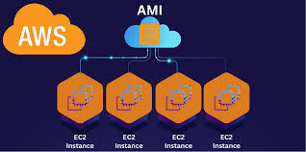
AMAZON MACHINE IMAGE (AMI)
An AWS AMI (Amazon Machine Image) is a pre-configured template that includes the operating system, software, and settings of an EC2 instance. It helps you quickly launch new EC2 instances with the same setup.
Select instance and click on the Actions button at the top.
From the dropdown, choose Image and templates > Create image.
Image Name
Once you’ve configured the settings, click on the Create Image button.

Slide 13
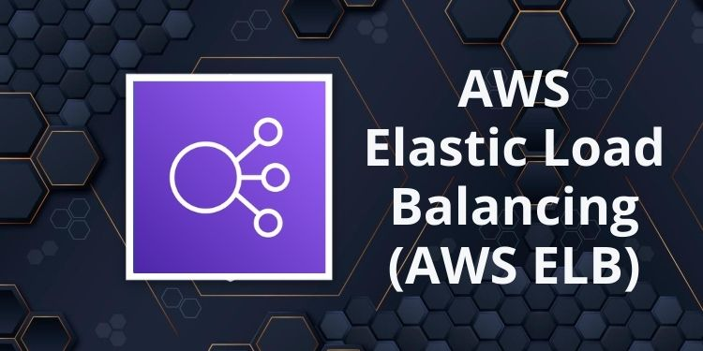
LOAD BALANCER
A load balancer helps distribute incoming traffic evenly across multiple servers, making sure no server gets overwhelmed.
Launch Two EC2 Instances
Install Nginx and Apache on Each Instance
Create a Security Group for Both Instances and the LB
Create load balancer Configure Load Balancer
Launch the Load Balancer
Copy its DNS and paster it in browser

Slide 14
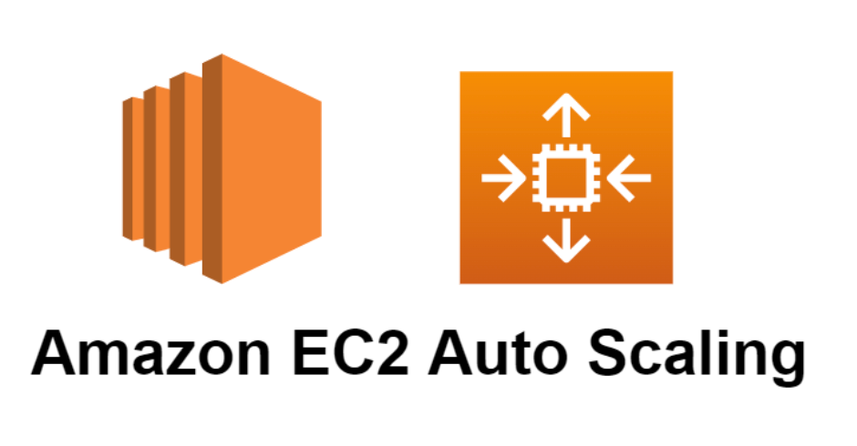
AUTO SCALING GROUPS & LAUNCH TEMPLATE
ASG: Auto Scaling in AWS automatically adjusts the number of EC2 instances based on your application's traffic.
Launch Template: This template will define the configuration for your EC2 instances, such as the operating system, instance type, and other settings.
Create a Launch Template
Create an Auto Scaling Group
Increase Instance Capacity
Monitor Auto Scaling

Slide 15
RDS (RELATIONAL DATABASE)
AWS RDS (Relational Database Service) is a fully managed service that simplifies the process of setting up, running, and scaling relational databases like MySQL, PostgreSQL, and SQL Server in the cloud. It takes care of maintenance tasks such as backups, patching, and scaling, so you can focus on your application.
Set Up RDS: Launch a MySQL database instance through the AWS Management Console.
Configure Security Group: Modify the security group to allow incoming traffic on port 3306 for MySQL access.
Connect from EC2: Use a MySQL client on your EC2 instance to connect to the RDS MySQL database.

Slide 16

GIT MINI PROJECT - 2
- SPANDANA BAINDLA

Slide 17

AGENDA
LAB -1 CREATING EC2 INSTANCE
LAB -2 CREATE REPOSITORY IN LOCAL MACHINE
LAB -3 CREATE REPO IN REMOTE LOCATION –(GITHUB)
LAB -4 WORKING WITH REMOTE REPO
LAB -5 PUSING LOCALLY CREATED REPO TO GITHUB
LAB -6 CREATING NEW BRANCH FROM YOUR MAIN BRANCH
LAB -7 PULL ALL THE BRANCHES IN LOCAL MACHINE
LAB -8 MERGE OUR FEATURE BRANCH WITH OUR MAIN BRANCH
LAB -9 GO TO LOCAL MACHINE

Slide 18

WHAT IS GIT?
Git is a version control system used to track changes in code or files. It helps developers work together by keeping a history of changes and making it easy to collaborate.

Slide 19
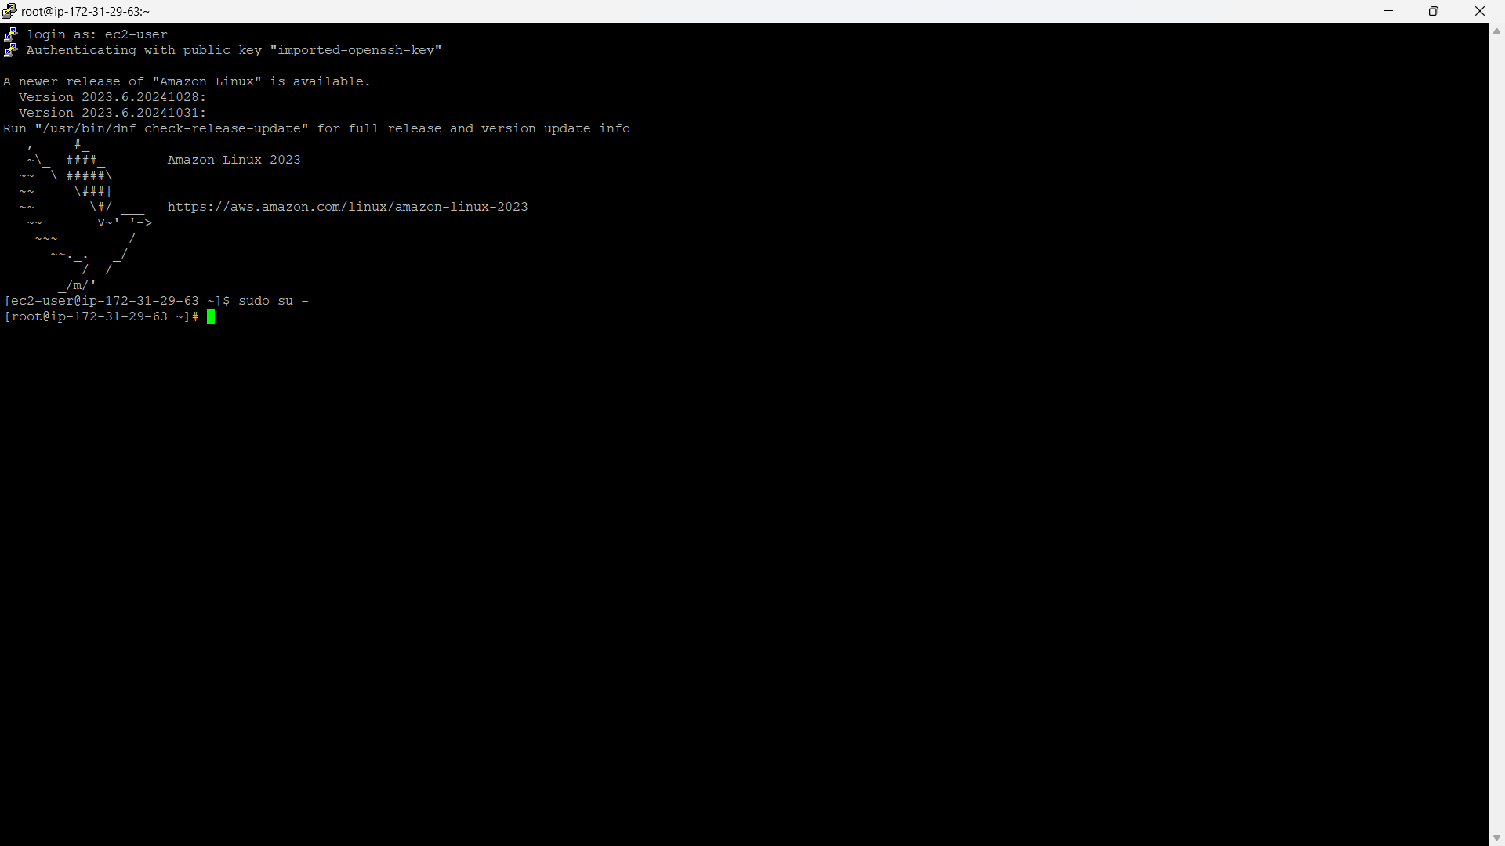
CREATING EC2 INSTANCE
Launch the instance with the amazon linux2 AMI connect the server with the PuTTY

Slide 20
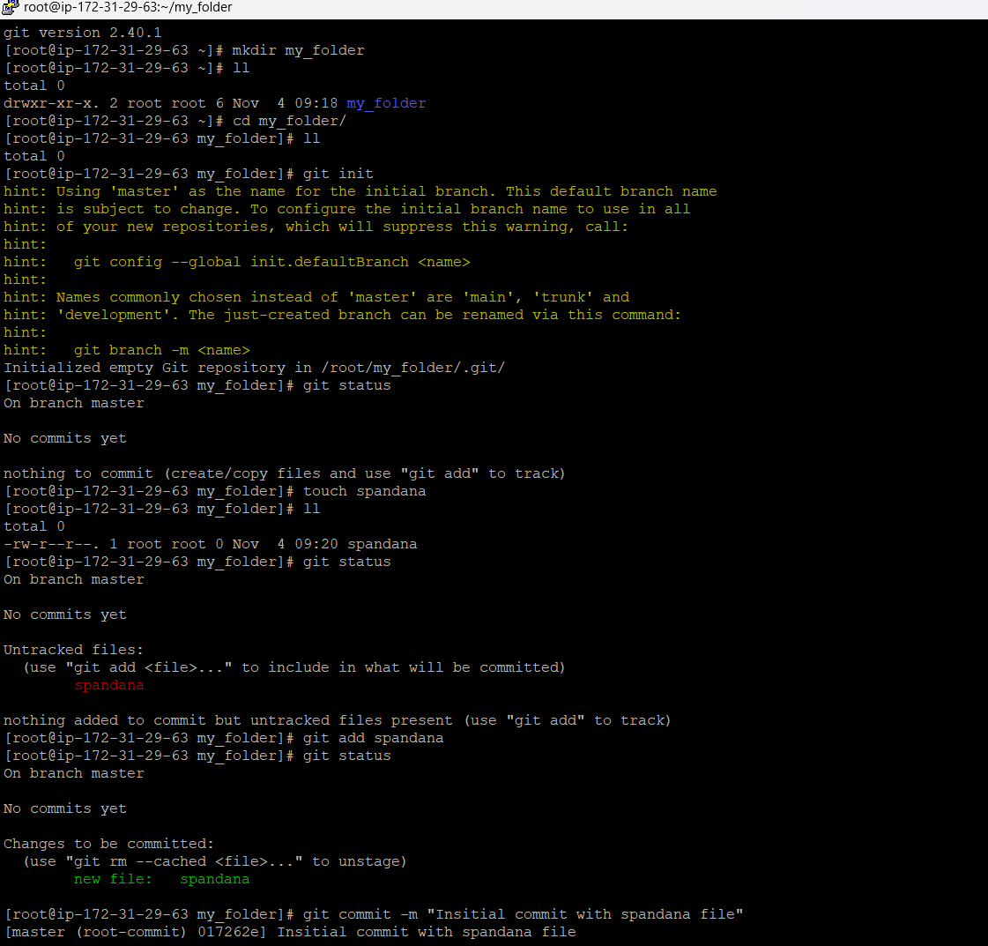
CREATING REPO IN THE LOCAL MACHINE
1. Set Up Repository
Make a new folder on your computer.
Open a terminal, navigate to the folder, and initialize Git with git init.
2. Verify Repository Status
Run git status to see that the repository is currently empty.
3. Add a New File
Create a new file with touch test.
Run git status again to see the file listed as untracked.
4. Stage and Commit Changes
Stage the file with git add test.
Commit it to the repository with git commit -m "added test file".
5. Confirm Final Status
Run git status once more to confirm the working directory is now clean

Slide 21
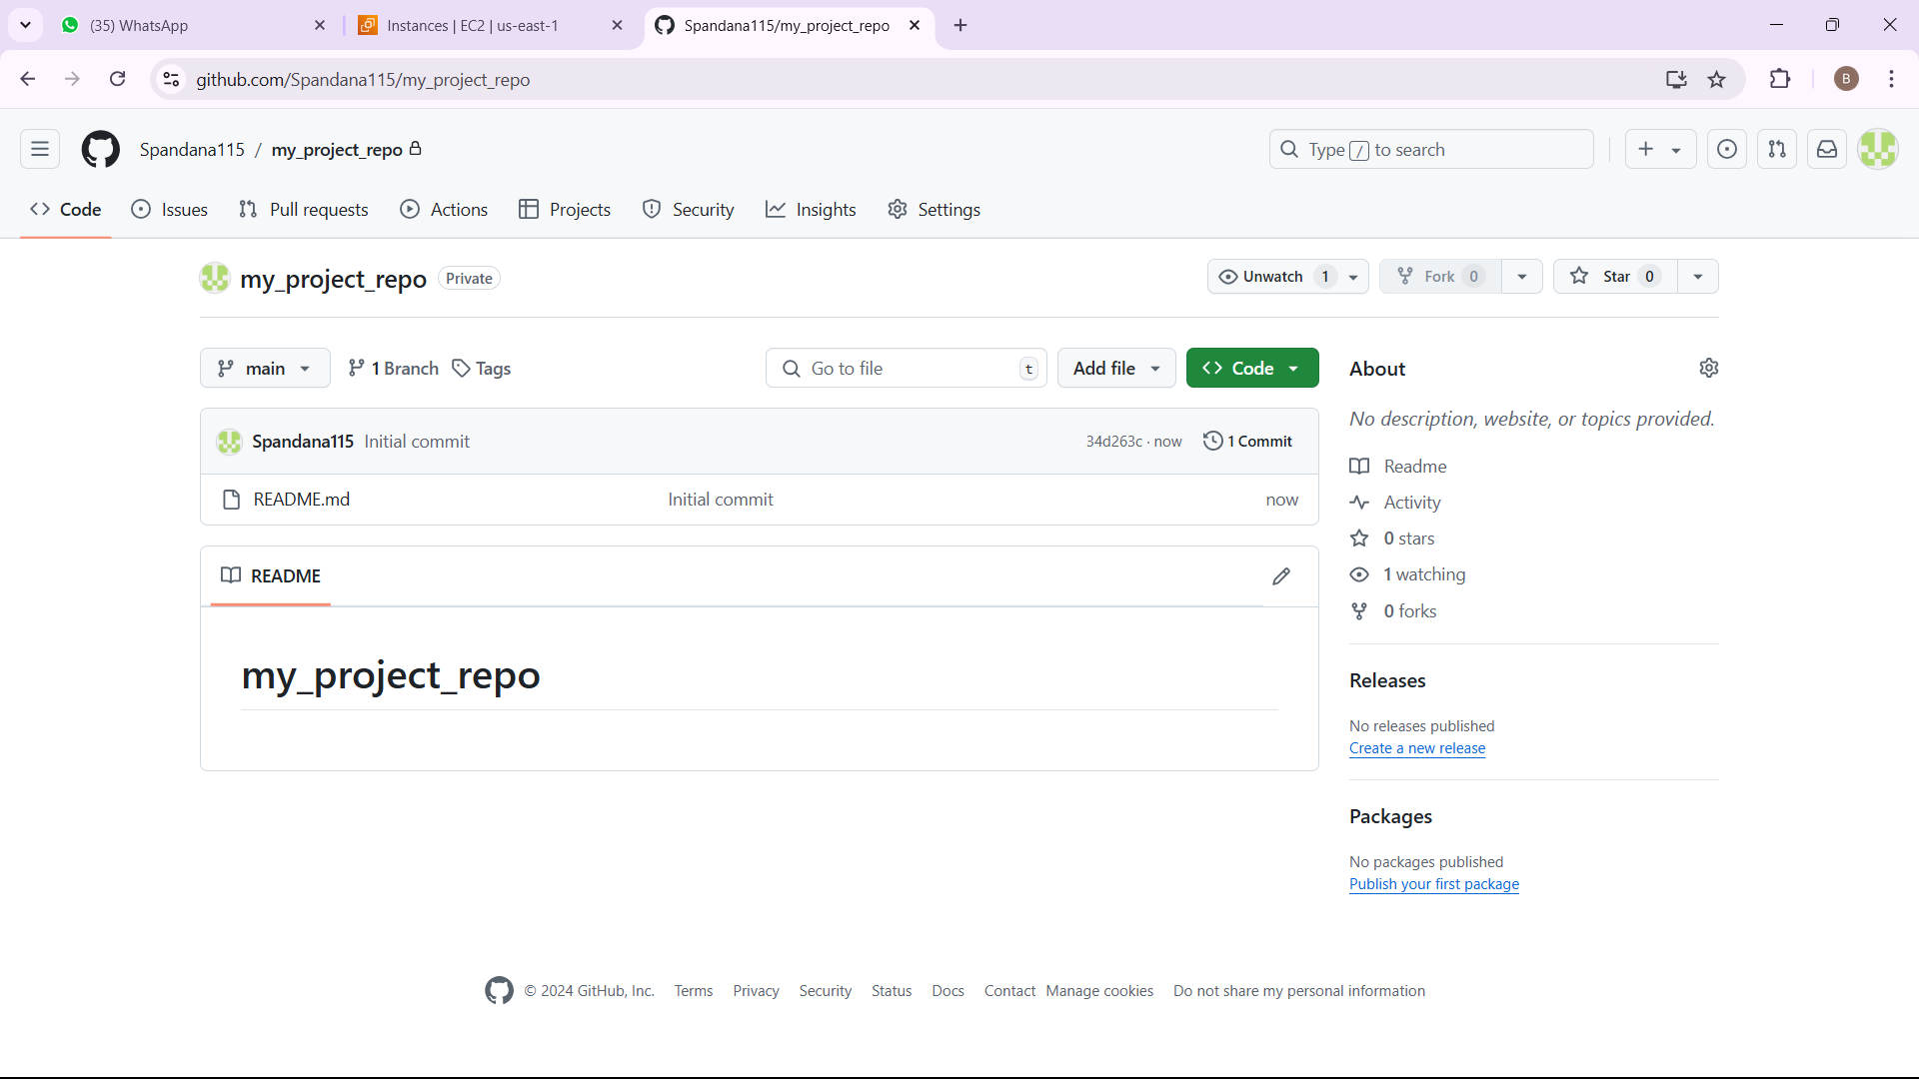
CREATING REPO IN REMOTE LOCATION
Open GitHub Account: Log in to your GitHub account.
Navigate to Repositories: Click on the Repositories tab in your profile to view all repositories.
Create a New Repository: Click the New button to start creating a new repository.
Add README File: Fill in the repository details, and check the option to Add a README file. This will create a default README.md file in the new repository.
Complete Creation: Click Create Repository to finalize.

Slide 22
WORKING WITH REMOTE REPO
Clone the Repository from GitHub: Copy the repository’s HTTPS URL, then run git clone <URL> in your terminal to download it to your local machine.
Make Changes and Commit: Edit files as needed, then stage and commit with git add . and git commit -m "made changes".
Generate a Personal Access Token: On GitHub, go to your profile, select Settings > Developer settings > Personal access tokens. Generate a new token with the necessary permissions.
Clone Using the Personal Access Token: Clone the repository again if needed, and use the token as the password when prompted.
Create New Files and Commit: Use touch <filename> to create new files, then stage and commit with git add . and git commit -m "added new files".
Push Changes: Push the changes to GitHub with git push, using your username and the token as the password.
Verify Changes on GitHub: Go to your repository on GitHub to confirm that all updates appear in the remote repository.

Slide 23
PUSHING LOCALLY CREATED REPO TO GITHUB
1. Create a Local Repository:
In your terminal, navigate to the directory where you want to create the repository.
Initialize Git with git init.
2. Create a Repository on GitHub:
Go to your GitHub account, navigate to Repositories, and click New.
Name the repository the same as your local folder, and click Create Repository.
3. Open Terminal and Run Commands:
Rename the Branch: Use git branch -M main to rename the current branch to "main" (or make sure it aligns with your GitHub branch name).
Add Remote Repository: Run git remote add origin <URL>, replacing <URL> with the URL of your GitHub repository.
Push to GitHub: Use git push -u origin main to push your local repository's main branch to GitHub. This also sets up the remote tracking for future pushes.

Slide 24
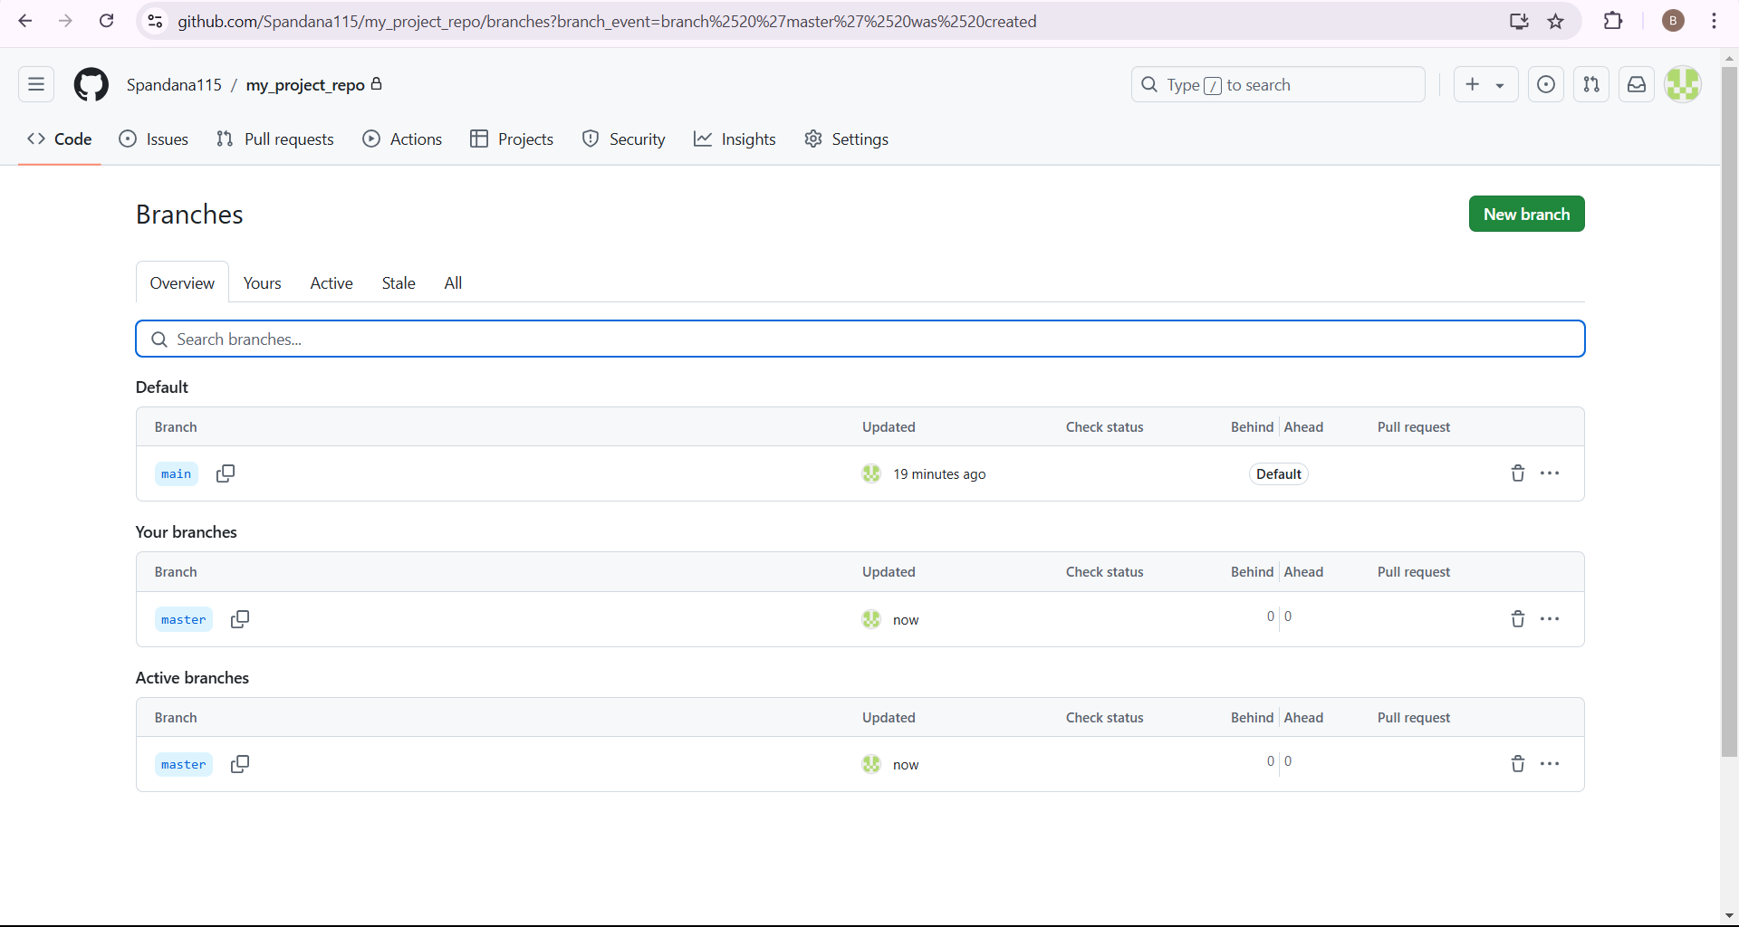
CREATE A NEW BRANCH FROM YOUR MAIN BRANCH
Open GitHub Repository: Go to your repository on GitHub where the main branch is located.
Create a New Branch: Click Branch > New Branch and name it.
Make Changes in New Branch: Add text files or other changes in this branch.
Note: Changes in this new branch won’t affect the main branch until merged.

Slide 25
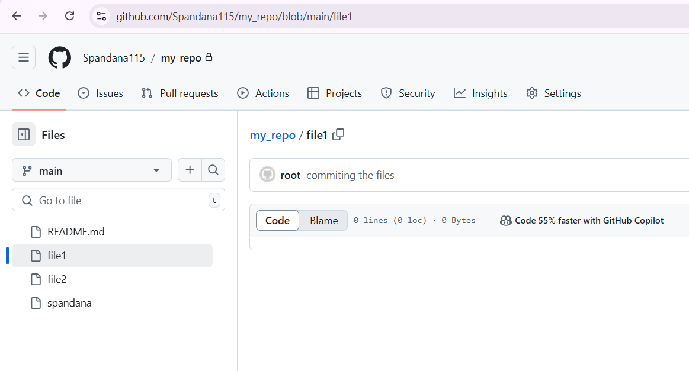
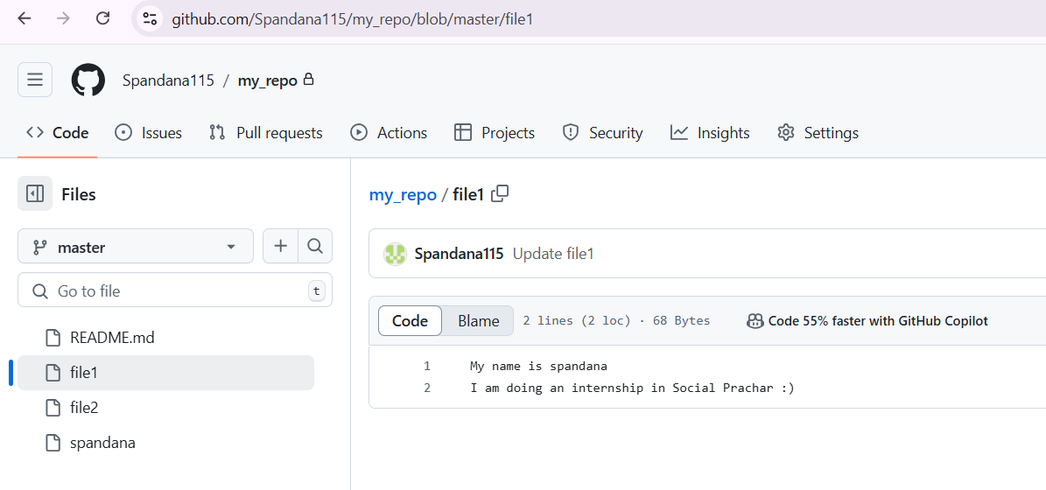
PULL ALL THE BRANCHES IN YOUR LOCAL MACHINE
Pull the Repository: On your local machine, run git pull to sync with the remote repository.
Switch to New Branch: Check available branches with git branch, then switch to the new branch using git checkout <branch name>.
Make Changes: Create files or make edits in this branch.
Push Changes: Stage and commit the changes, then push them to the remote branch using git push.
Note: Changes in this feature branch won’t affect the main branch until merged.

Slide 26
MERGE OUR FUTURE BRANCH WITH MAIN BRANCH
Check the New Branch on GitHub: Go to your GitHub repository and ensure the new branch is visible.
Create a Pull Request: Go to the Pull Requests tab and click New Pull Request.
Select Branches: Choose the main branch as the base and the feature branch as the compare branch.
Review and Merge: Click Create Pull Request, review any changes, and then click Merge to combine the branches.
Verify Changes: Go to the main branch’s code to see the newly merged changes.

Slide 27
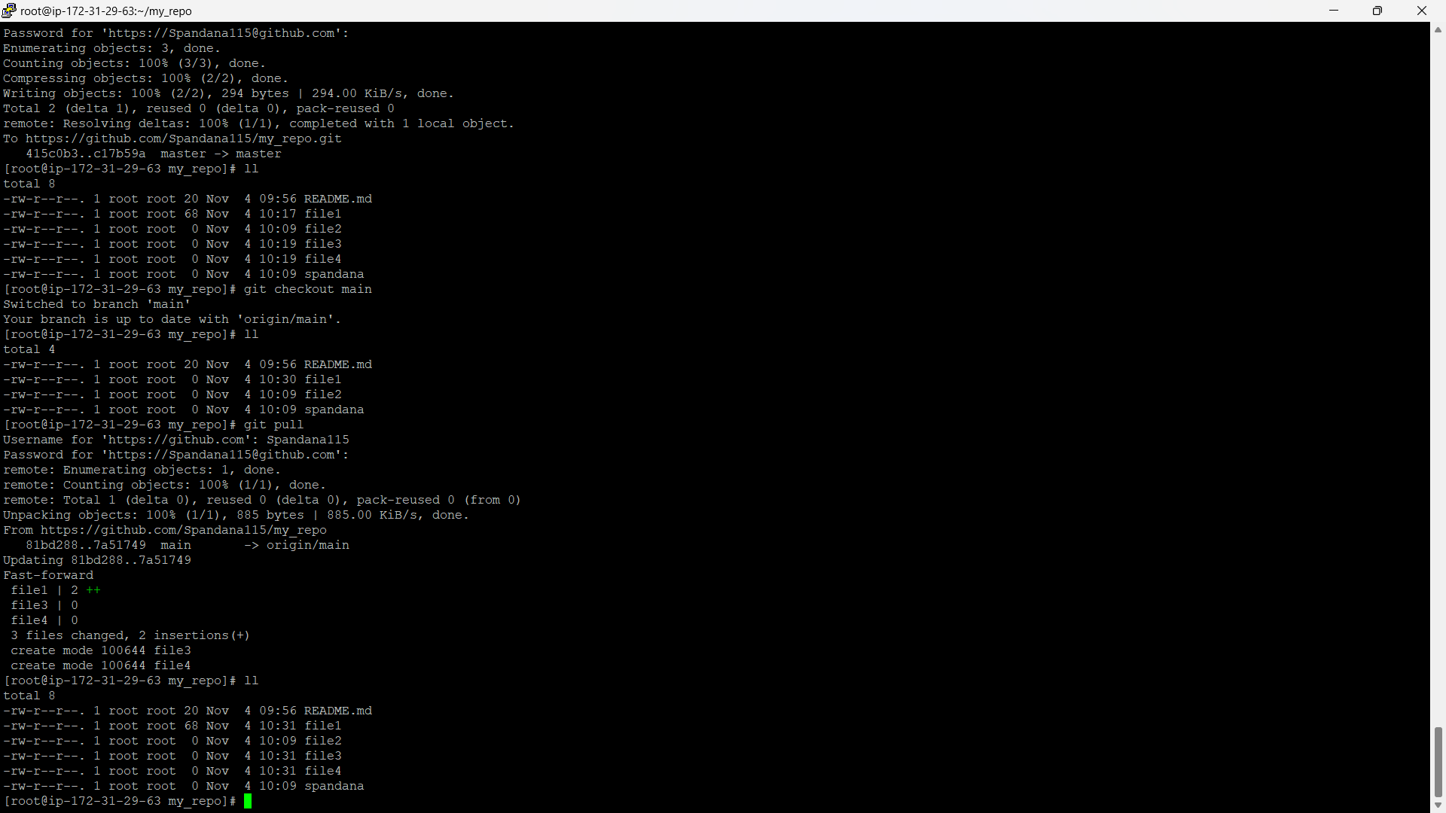
GO TO THE LOCAL MACHINE
Open Local Repository: On your local machine, navigate to the folder with the cloned repository.
Switch to Main Branch: Run git checkout main to move to the main branch.
Pull Updates: Use git pull to fetch and integrate the latest changes from the remote repository.
Now, the main branch on your local machine will have all recent updates from the remote repository.

Slide 28
THANK YOU ☺

